Slide 1


MG Cainiao Layout & Flow Process & Packaging Type
12.780 m2
Rio Firnando
02/04/2023

Slide 2
MG Cainiao Auto CAD Layout

Slide 3

MG Cainiao Layout Visualization
BIW STORAGE AREA 168 RACK (336 BIW)
TRANSIT 4
TRANSIT 3
UNPACK AREA
TRANSIT 2
TRANSIT 1
CBD-B02 BIG PART DLOC
CSD-A16
DG STORAGE
UNPACK AREA
CSD-A14 CSD-A15
CSD-A01
CSD-A02
CSD-A03
CSD-A04 CSD-A05
CSD-A06 CSD-A07
CSD-A08
CSD-A09
CSD-A10
CSD-A11
CSD-A12 CSD-A13
SMALL PART OVERFLOW AREA
MOQ AREA
CBD-B01 BIG PART DLOC
TRANSIT 6
TRANSIT 5
NC AREA
7
EMPTY RACK
Transit 8
Transit 7
BIW BUFFER AREA
6
LOADING AREA
WASTE AREA
MG4 HC
FL CHARGE
BATTERY STORAGE
5
EZS TR
EZS TR
MG4 TR
MG4 TR
EZS FN
EZS FN
EZS LC
EZS HC
MG4 FN
MG4 FN
MG4 LC
330 BATTERY
4
BUMPER BUFFER
OFFICE CNO
OFFICE
CNO
32 BIW
3
OFFICE CNO
2
BIW
1
SUSPENSION AREA
OFFICE PANLI

Slide 4

MG Cainiao Layout Glossary
: BIW Area
: Big Part Dloc
: Small Part Dloc
: SPS Area
: Battery Storage Area
: Transit Area
: Window Area
: Small Part Overflow Area
: Loading/Outbound Area
: MOQ Area
: Unpack Area
: BIW & Part Buffer Area
: Hoist Area
: Rolling Door
: Office (Cainiao & Panli)
: NC Area
: Waste Area

Slide 5
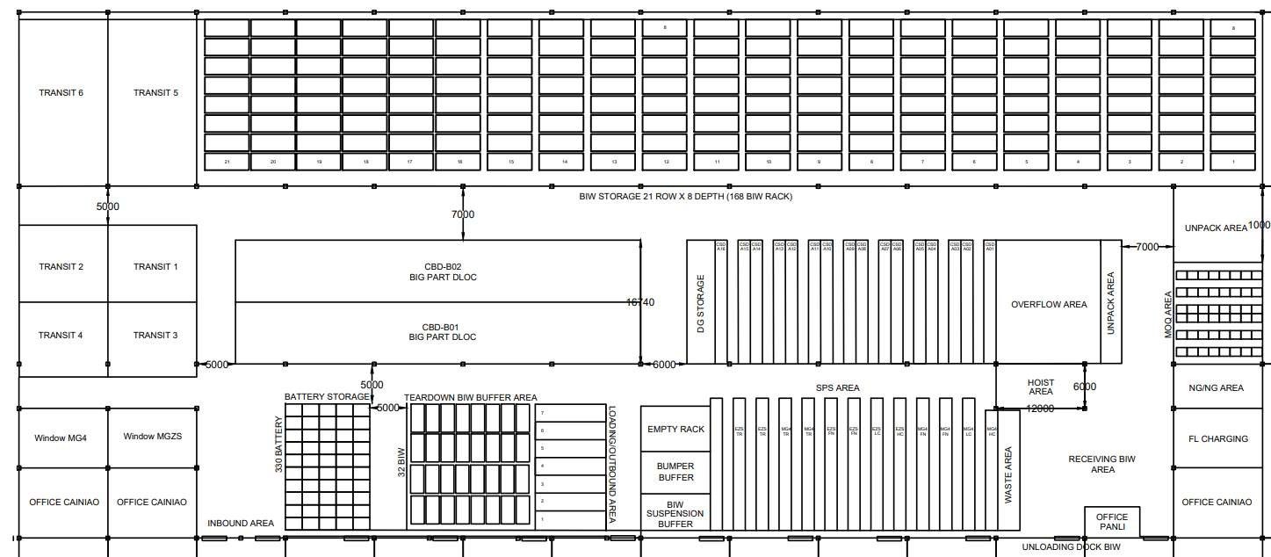
BIW Inbound-Outbound Flow Process
3
4
2
5
1
Receiving/Inbound from KD
Receive in Transit Area (Recorder Scan Inbound)
Putaway to BIW Storage Area
Tear down & Fill to SKID, then move to Loading Area
5.
Loading to MR at Outbound Area

Slide 6
Direct & JIS Inbound-Outbound Flow Process
2
BIG PART DLOC 3
SMALL PART DLOC 3
2
2
1
4
1
5
Receive at Inbound Area (Recorder Scan Inbound)
Putaway to Transit Area
Fulfill to Dloc (Small, Medium and Big Part)
Picking and Move to Loading Area
5.
Loading to MR at Outbound Area

Slide 7
Direct & JIS Inbound-Outbound Flow Process
2
BIG PART DLOC 3
SMALL PART DLOC 3
2
2
1
5
4
1
6
Receive at Inbound Area (Recorder Scan Inbound)
Putaway to Transit Area
Fulfill to Dloc (Small, Medium and Big Part)
Fulfill to Uloc/SPS Area (TR,HC & LC, FN)
Picking to SPS Kart
6.
7.
Move to Loading Area
Loading to MR at Outbound Area
6

Slide 8
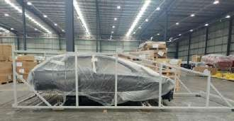
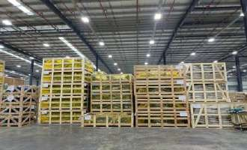
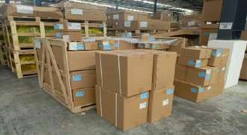
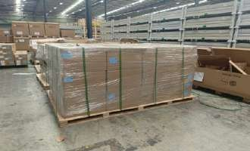
MG Packaging Type (Inbound)
Content | Category | Packaging Type
 | BIG PART SINGLE | BIW RACK
 | BIG PART SINGLE | WOODEN CASE
 | BIG PART MIX | WOODEN CASE
 | BIG PART MIX | CARTON BOX + PALLET

Slide 9
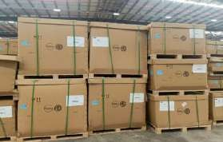
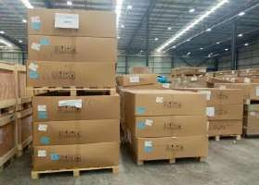
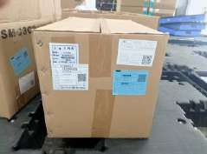
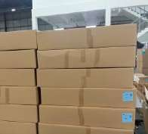
MG Packaging Type (Inbound)
Content | Category | Packaging Type
 | MEDIUM PART SINGLE | CARTON CASE
 | MEDIUM PART SINGLE | CARTON BOX + PALLET
 | SMALL PART SINGLE | CARTON BOX

Slide 10








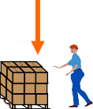





Receiving & Inbound Process (Cainiao)
China Supplier
Supplier Preparation
Prepare and publish in advance
Shipping Advice
VSN BOM
Window time
Compare BOM & SA
Create Storing list
Create Monitoring list
Email
Hardcopy
Softcopy
Arrive at the specified window time
Cainiao loading DOCK
Receipt Verification (Delivery Note)
Receipt Verification (Delivery Note)
DOCK unloading
Barcode scanning
Normal
Barcode
is valid
Put away & divided by batch/LOT
KD Transit Area
International Shipping
Shipping customs clearance
Material Status Check
SGMW Stamp
Scan Package
Input Date
Barcode scanning
Relocate to
Storage divided
By Part Style
Abnormal
Storage Area
 | Abnormal Analysis
Storage Area
Input Address
Problem Solving
Report to
China Supplier
LES
WMS
Supplier prepare all document for export to Indonesia
SGMW will check the hardcopy of receipt verification (delivery note)
SGMW will check the receiving package, giving stamp and scan
SGMW will do analysis for abnormality
Inventory check the softcopy of receipt verification (delivery note)
2 Recorder will do inbound process (Unloading-Putaway to Storage)
Inventory doing analysis using BOM & SA, If a miss part is found from the results of comparing SA and BOM, Inventory report to PPMC SGMW
1

Slide 11


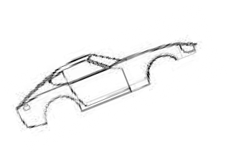















BIW Flow Process
Prepare and publish in advance
Production plan
Create VSN Production plan
Create & Print Picking list
Email
Barcode scanning
Picking use FIFO rules
Material preparation
Input take out date
Storage Area
Big mix case
Unpack process
WMS
Carton Box
Process to
Repack Area (Small part)
Give part label
LES
BIW
Outbound Scanning
 | Suspicious material analysis
Report to SGMW
NC & NG
Suspicious Parts
Repack Area
Qualified parts
Area
BIW
Put on SKID
Transfer to LOC
Preparation Area
Move to
Preparation Area
Create production plan for MG
Receive report from PANLI for NC & NG Part
Repack planner will do analysis from production plan, then create the picking list
Picking use FIFO rules
If operator found NC & NG part, move to NC & NG Area then report to SGMW
Unpack BIW using hoist, the small part will be move to repack area
After unpack finish, qualified parts BIW will be put on SKID and then move to preparation area
5

Slide 12




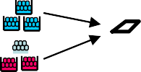

SPS Flow Process
Prepare and publish in advance
Production plan
Create VSN Production plan
Create & Print Picking list
Print label
Barcode scanning
Email
Picking use FIFO rules
Material preparation
After Unpack
Input take out date
Empty Case Move to
Waste Area
Storage Area
Small part case
ALSCO
Unpack process
WMS
LES
Give part label
Outbound
Scanning
 | Suspicious material analysis
Report to SGMW
Suspicious parts
Repack Area
Unpack Carton Box Process
Qualified parts
Fill to SPS Chart
NC & NG
Area
SPS Chart
Transfer to LOC
Preparation
Area
Move to Preparation Area
Create production plan for MG
Receive report from PANLI for NC & NG Part
Repack planner will do analysis from production plan, then create the picking list
Picking use FIFO rules
If operator found NC & NG part, move to NC & NG Area then report to SGMW
• After unpack finish, qualified parts will fill to SPS Chart and then move to preparation area
2

Slide 13








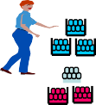


JIS/Direct Big Part Flow Process (Special Rack)
Prepare and publish in advance
Production plan
Create VSN Production plan
Create & Print Picking list
Print label
Barcode Picking use scanning FIFO rules
Email
After unpack
Material
preparation Input take
out date
Big part case
Empty Case Move to
Waste Area
Storage Area
Unpack process
WMS
LES
Give part label
Outbound Scanning
Report to SGMW
Suspicious
material analysis
NC & NG
Area
Suspicious parts
Qualified parts Fill to Special Rack
Special Rack
Repack Area
Big Part
Transfer to LOC
Move to
Preparation Area
Preparation
Area
Create production plan for MG
Receive report from PANLI for NC & NG Part
Repack planner will do analysis from production plan, then create the picking list
Picking use FIFO rules
If operator found NC & NG part, move to NC & NG Area then report to SGMW
• After unpack finish, qualified parts will fill to Special Rack and then move to preparation area
3

